Slide 1

Computational Foundations of Cyber Physical Systems (CS61063)
Cyber World
Controller
Controller
Controller
…............
Physical Sys1
Physical Sys2
Physical Sys3
APPLICATION OF CONTROL THEORY IN RT-SCHEDULING
Soumyajit Dey
CSE, IIT Kharagpur

Slide 2
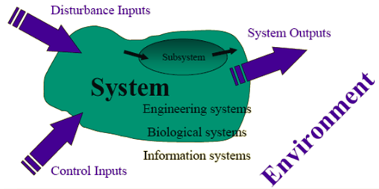
Control Theory
Control is a process of causing a system variable to follow some desired value called reference value.
A control system is one which can control any quantity of interest in a machine, mechanism or other equipment in order to achieve the desired performance or output.
Control Theory deals with the behavior of Dynamical Systems with inputs, and how their behavior is modified by feedbacks to maintain a desired performance.

Slide 3
Application of Control theory in scheduling
Abdelzaher, Tarek F., John A. Stankovic, Chenyang Lu, Ronghua Zhang, and Ying Lu. "Feedback performance control in software services." IEEE Control Systems Magazine 23, no. 3 (2003): 74-90.
﻿Described the internal architecture of a typical Web server, present its dynamic model, and elaborate on the equivalents of sensors and actuators in this computing system.
Discussed how the application of classical feedback control offers a solution to the problem of achieving performance guarantees for the software systems with an example of Web Servers.

Slide 4
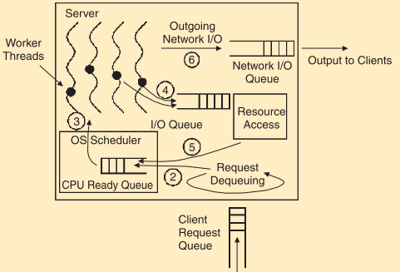
Feedback performance control in software services
Web Service Architecture for a ﻿distributed client-server system in which succession of requests (many thousands of requests per second ) arrives at a server from clients across a communication network.
﻿For the server to yield acceptable performance, the order of request service times must be much smaller than the order of tolerable server response times.

Slide 5
Feedback performance control in software services
A key prerequisite to system modeling is to define the actuators and their manipulated variables. Actuators in web server can be classified –
Quality Adaption Actuators – Alters the processing requirements of the service request. It offers a flexible tradeoff between delay and quality.
Resource Reallocation Actuators - Alters the amount of resources available for the processing of the request queue.
Input Flow Actuators - Manipulates the input workload of a server and used when different clients have different priority.
Performance metrices can be–
﻿Queuing delays, execution latencies, and service response times.
Connection bandwidth, service throughput, and packet rate.
Derived metrics like the relative delay of two traffic classes, hit of a cache

Slide 6
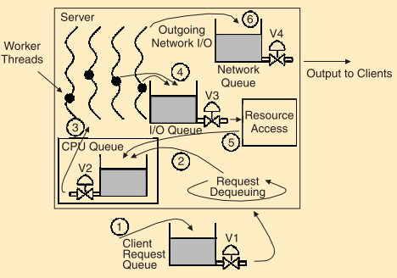

Feedback performance control in software services
Service modeling
y(k) denotes the output or performance (e.g., delay or Queue throughput) reported at the kth sampling instant.
﻿u(k) denotes the control input at k^{th} instant
﻿x(k) is the state vector
A, b and C describe the system model.

Slide 7
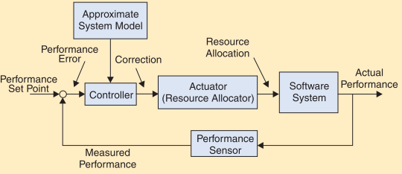
Feedback performance control in software services

Slide 8



Real-time Systems
A real-time system is any information processing system that has to respond to externally generated input stimuli within a finite and specified period.
The correctness depends on not only the logical result but also the time it is delivered.
Failure to respond is as bad as the wrong response.

Slide 9
Application of Control theory in scheduling
Lu, Chenyang, John A. Stankovic, Sang H. Son, and Gang Tao. "Feedback control real-time scheduling: Framework, modeling, and algorithms." Real-Time Systems 23, no. 1 (2002): 85-126.
﻿ This paper presents a framework for adaptive real- time systems with following contributions-
A scheduling architecture that maps the feedback control structure to adaptive resource scheduling in real-time systems
A set of performance specifications and metrics to characterize both transient and steady state performance of adaptive real-time systems
A control theory based design methodology for resource scheduling algorithms to satisfy system performance specifications.

Slide 10
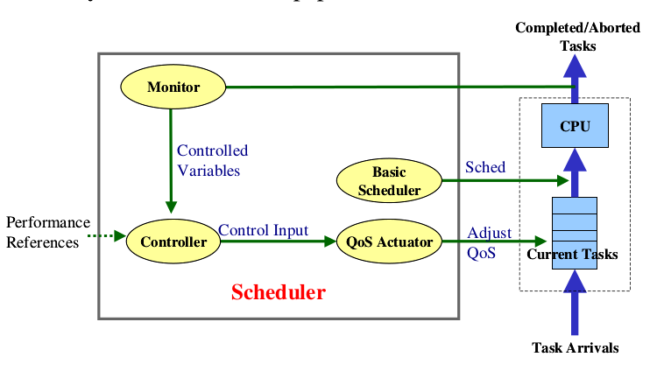
Feedback Control Real-Time Scheduling: Framework, Modeling, and Algorithms
Monitor (﻿measures the controlled variables )
Controller (﻿compares the performance references with corresponding controlled variables and computes a change called the control input based on the errors)
Qos Actuator (﻿dynamically changes the total estimated requested performance at each sampling instant k according to the control input by adjusting the QoS levels of tasks)
Basic Scheduler (﻿schedules admitted tasks with a scheduling policy e.g., EDF or Rate/Deadline Monotonic)
FCS (Feedback Control Scheduling)
architecture-
Notes:
The Basic Scheduler schedules admitted tasks with a scheduling policy.
The Monitor measures the deadline miss ratio and CPU utilization at the kth sampling instant and feeds the samples back to the Controller.
The Controller compares the performance references with corresponding controlled variables to get the current errors.
The QoS Actuator dynamically changes the total estimated requested utilization according to the control input by adjusting the QoS levels of tasks.

Slide 11
Task Model

Slide 12
Feedback Control Real-Time Scheduling: Framework, Modeling, and Algorithms
Performance Specifications and Metrics:
Performance Profile:
Stability, Transient-state response, Steady-state error, Sensitivity
Control related variables:
﻿Miss ratio M(k) at the k^{th} sampling instant is defined as the number of deadline misses divided by the total number of completed and aborted tasks in a sampling window
﻿Utilization U(k) at the k^{th} sampling instant is the percentage of CPU busy time in a sampling window

Slide 13



Feedback Control Real-Time Scheduling: Framework, Modeling, and Algorithms
Modeling Control system﻿
The control input to the controlled system is the change in the total estimated utilization DB(k). The output of the controlled system includes the controlled variables, miss ratio M(k) and utilization U(k).
﻿Derivation of model from the control input to the output-
B(k) and B(k+1) are the ﻿total estimated utilization in the current and next sampling instant respectively and DB(k) is the control input at every sampling instant k
﻿Since the precise execution time of each task is unknown and time varying, the total (actual) requested utilization A(k) may differ from the total estimated requested utilization B(k). ﻿G_{a}(k), called the utilization ratio, is a time-variant variable that represents the extent of workload variation in terms of total requested utilization.
Since G_{a}(k) is time variant, we use the maximum possible value G_{A} = max{G_{a}(k)}, called the worst-case utilization ratio

Slide 14

Feedback Control Real-Time Scheduling: Framework, Modeling, and Algorithms
﻿The relationship between the total requested utilization A(k) and the controlled variables are nonlinear due to saturation, i.e., the controlled variables remain constant when the control input DB(k) ≠ 0.
Based on previous equations, the analytical model for the utilization output is as following:
When the CPU is underutilized (A(k) ≤ 1), the utilization U(k) is outside its saturation zone and equals A(k);
When the CPU is overloaded, however, U(k) saturates at 1 because it can never exceed 100%.

Slide 15


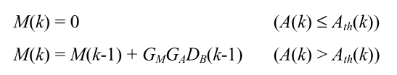
Feedback Control Real-Time Scheduling: Framework, Modeling, and Algorithms
Derivation of the model for the miss ratio output M(k)
In contrast with U(k) that saturates in overload conditions, M(k) saturates at 0 when the CPU is underutilized, i.e., the total requested utilization is below a utilization threshold A_{th}(k) for the system’s particular workload in the k^{th} sampling period.
When A(k) > A_{th}(k), M(k) usually increases nonlinearly with the total requested utilization A(k).Relationship between M(k) and A(k) needs to be linearized by taking the derivative at the vicinity of the performance reference M_{S} as the miss ratio factor G_{m.} The miss ratio factor G_{m} can be estimated experimentally by plotting a miss ratio curve as a function of the total utilization based on experimental data.
﻿Given the miss ratio factor, we have the following linearized formula for the purpose of control design:
Where G_{M} is the maximum slope at the vicinity of M_{S} in control design to guarantee stability.
The analytical model for the miss ratio output:

Slide 16
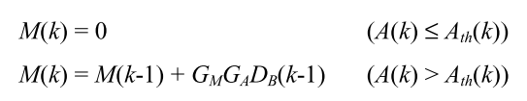


Feedback Control Real-Time Scheduling: Framework, Modeling, and Algorithms
﻿Analytical model for the
miss ratio output-﻿
Analytical model for the
utilization output-
﻿Equivalent transfer functions
outside their own unsaturated zones
Notes:
(1-z^{-1})M(z) = G_MG_Az^{-1}D_B(z)\\
\frac{M(z)}{D_B(z)}=G_MG_A\frac{z^{-1}}{(1-z^{-1})}=G_MG_A\frac{1}{(z-1)}

Slide 17
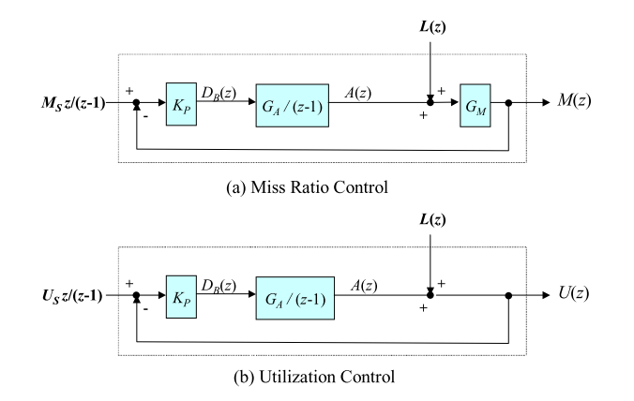

Feedback Control Real-Time Scheduling: Framework, Modeling, and Algorithms
Models of Feedback Control Loops:
They have used use a simple P (Proportional) control function to compute the control input.
Where,
D_{B}(k) = Control Input
K_{P} = a Tunable Parameter
E(k) = Error of the controlled variable

Slide 18
Application of Control theory in scheduling
Mishra, Nikita, Connor Imes, John D. Lafferty, and Henry Hoffmann. "Caloree: Learning control for predictable latency and low energy." ACM SIGPLAN Notices 53, no. 2 (2018): 184-198.
﻿ This paper presents a control theory based resource manager that learns key control parameters to meet latency requirements with minimal energy at runtime for dynamic system.
A scheduling architecture that maps the feedback control structure to adaptive resource scheduling in real-time systems
A set of performance specifications and metrics to characterize both transient and steady state performance of adaptive real-time systems
A controller for resource scheduling algorithms to satisfy system performance specifications.
﻿A learner to customize control systems at runtime, ensuring application latency both formally and empirically with no prior knowledge of the controlled application

Slide 19
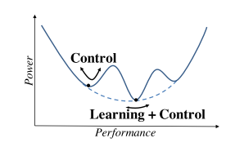
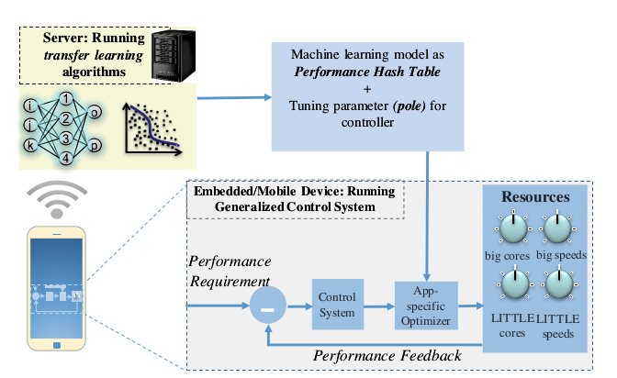
CALOREE: Learning Control for Predictable Latency and Low Energy
Workflow between Learner and Controller
The controller sends the learner a new application’s name and device type.
The learner determines how many samples are needed for an accurate prediction.
The controller takes these samples and sends the latency and power of each measured configuration to the learner.
The learner predicts the optimal configurations which uses the learned model from then on.

Slide 20
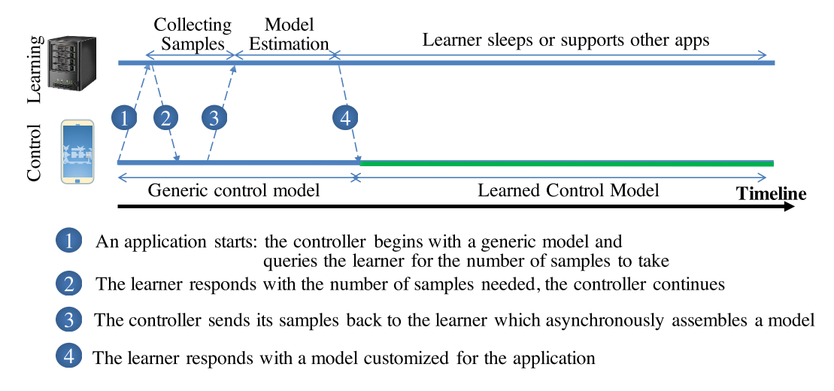
CALOREE: Learning Control for Predictable Latency and Low Energy
﻿Temporal relationship of learning and control

Slide 21
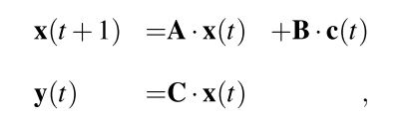
CALOREE: Learning Control for Predictable Latency and Low Energy
Traditional control for computing
Where,
﻿x ﻿∈ ℝ^{q} is is the controller’s state, capturing the relationship between resources and goals; q is the controller’s degree, or complexity of its internal state
u(t) ∈ ℝ^{n} represents the current resource configuration; i.e., the i^{th} vector element is the amount of resource i allocated at time t.
y(t) ∈ ℝ^{m} represents the value of the goal dimensions at time t.
The matrices A ∈ ℝ^{qxq} and B ∈ ℝ^{qxn} relate the resource configuration to the controller state. The matrix C ∈ ℝ^{mxq} relates the controller state to the expected behavior.
This control definition does not assume the states or the resources are independent, but it does assume a linear relationship.
Eq. 1

Slide 22
CALOREE: Learning Control for Predictable Latency and Low Energy
Drawbacks of traditional control:
﻿requires matrix computation, and has high overhead
﻿adaptive mechanisms are not parameter-free
need prior knowledge of ﻿user-specified parameters
CALOREE transforms a standard control system into one that works without prior knowledge of ﻿user-specified parameters by -
﻿controlling speedup (an abstraction on performance) rather than resources
﻿translating speedup into an energy minimal resource schedule in a separate step
﻿exploiting the problem structure to solve scheduling problem in constant time
﻿These steps assume a separate learner has produced predictions of how resource usage affects latency and power.

Slide 23

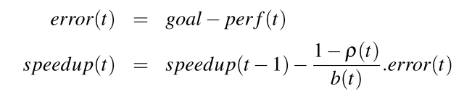
CALOREE: Learning Control for Predictable Latency and Low Energy
CALOREE’s control law
﻿CALOREE converts traditional control Equation Eq.1 into a single-input (latency), single-output (speedup) controlling using A = 0, B = b(t), C = 1, u = speedup, and y = perf(t); where b(t) is a time-varying parameter representing the application’s base speed (the speed when all resources are available)and perf is the measured latency.
﻿﻿Using these substitutions, x is eliminated from Eq. 1 to relate speedup to latency by,
CALOREE targets to eliminate the error between the goal and calculated performance-

Slide 24
CALOREE: Learning Control for Predictable Latency and Low Energy
Controlling speedup
﻿CALOREE uses this control equation
﻿which states that the speedup at time t is a function of the previous speedup, the error at time t, the base speed b(t), and the controller’s pole, ρ(t).
Standard control techniques statically determine the pole and the base speed, but CALOREE dynamically sets the pole and base speed to account for error in the learner’s predictions.
For stable control, CALOREE ensures 0 ≤ ρ(t) < 1
﻿Small values of ρ(t) eliminate error quickly, but make the controller more sensitive to the learner’s inaccuracies whereas larger ρ(t) makes the system more robust at the cost of increased convergence time.

Slide 25
Maity, Srijeeta, Anirban Ghose, Soumyajit Dey, and Swarnendu Biswas. "Thermal-aware Adaptive Platform Management for Heterogeneous Embedded Systems." ACM Transactions on Embedded Computing Systems (TECS) 20, no. 5s (2021): 1-28.
﻿ This paper presents a framework for adaptive dynamic thermal management for real- time systems with following contributions-
Performs online thermal management of heterogeneous CPU-GPU platforms executing multiple real-time tasks that supports dynamic changes in the job set that can result in dynamic thermal violations
Provides an OpenCL run-time platform manager which adaptively handles dynamic thermal violations by formulating lightweight heuristic-guided scheduling solutions
Considered a combination of runtime task partitioning, migration, idleness insertion, and control theoretic DVFS as scheduling moves for CPU-GPU heterogeneous systems.

Slide 26
Thermal-aware Adaptive Platform Management for Heterogeneous Embedded Systems
Designing an efficient thermal-aware, adaptive resource manager, that is cognizant of the application performance, as well as the thermal profile, is a challenging problem for heterogeneous multi-cores.
Context: Car with ADAS approaching congested area from highway
Requirement: Increase rate of Pedestrian detection?
Dynamic change in job set
Dynamic Scheduling
Real-time constraint
Thermal constraint
Prior work does not address the issue of real-time task scheduling in CPU-GPU integrated systems while handling thermal violations in case of dynamic workload modifications
A-DTM
Need for adaptive, lightweight, thermal aware resource manager
Proposed framework

Slide 27

Thermal-aware Adaptive Platform Management for Heterogeneous Embedded Systems
CPU
GPU
OpenCL (Open Computing Language) is a framework for writing programs that execute across heterogeneous platforms. It provides a standard interface for parallel computing using task and data level parallelism on different compute devices such as CPU, GPU, FPGA and DSP.
Partitioning tasks in the context of OpenCL applications entail splitting the data space to be processed by the task/kernel into segments and processing the segments concurrently or sequentially using the devices of the heterogeneous system.
DSP
FPGA
CPU
GPU
Y% to GPU
K1
X% to CPU
CPU
GPU
time

Slide 28
Thermal-aware Adaptive Platform Management for Heterogeneous Embedded Systems
Methodology overview
For faster thermal recovery actions by modifying task mapping choices , the granularity of task mapping is reduced from tasks to sub-tasks level.
In the offline phase, the tasks are profiled extensively and suitable task partitioning size is computed and again profiled for getting the WCET for each sub task.
In the online phase, the subtasks are dispatched following an initial task schedule and the thermal behaviors are monitored . In case of thermal violations, a recovery controller gets triggered in the framework that modifies the task schedule adaptively.
𝜏_{i}
WCET lookup table
𝜏
Profile tasks
Choose suitable task partitioning size
Profile partitioned sub-task
Offline phase
Thermally stable schedule
Task schedule
Dispatch sub-tasks
Monitor thermal violation
Recovery controller
𝒥'
Initial
task mapping
Online phase
Updated task mapping

Slide 29
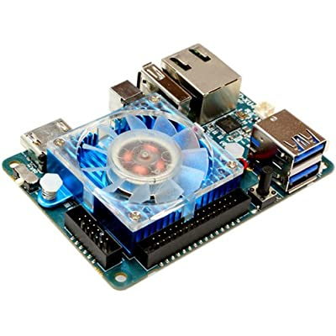
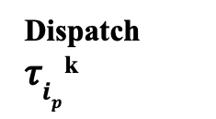


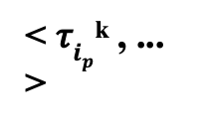

Thermal-aware Adaptive Platform Management for Heterogeneous Embedded Systems
They have considered two thermal thresholds- T_{Major} and T_{minor}
If peak temperature, during a task execution lies between T_{major} and T_{minor} local recovery is activated which makes some local changes in the task mapping of the immediate next sub to reduce the temperature.
If peak temperature goes beyond T_{major} Global recovery is activated to avoid default thermal throttling. Global recovery identifies the tasks responsible for major violation, and changes the task mapping of the concerned tasks for the next hyper-period and this continues until major violation is mitigated.
Updated schedule for next hyper-period
Schedule 𝑆
Updated mapping for next sub-task
in the same hyper-period
Dispatch 𝜏$i_{p}$^{k}
𝜏$i_{p}$^{k’}
Local recovery
Peak temperature
(𝐓)
𝒎’$i_{p}$^{k’}
𝐓_{major}> 𝐓 > 𝐓_{minor}
𝐓 < 𝐓_{minor}
𝐓 > 𝐓_{major}
< 𝜏$i_{p}$^{k} , ... >
Odroid XU-4
Global recovery
No violation
< 𝒎’$i_{p}$^{k} , ... >
Recovery
controller
No
update
Recovery controller workflow

Slide 30
Thermal-aware Adaptive Platform Management for Heterogeneous Embedded Systems
Minor Violation
Minor Violation
Local Controller
Local Controller
N^{th}
Hyper-period
CPU
Local recovery
GPU
Frequency tuning
Task migration
Sub-task of τ₁
Sub-task of τ₂
Sub-task of τ₃
Major Violation
Frequency tuning
CPU
CPU
...
...
Global recovery
GPU
GPU
interval
GlobalController
Task migration
N^{th} hyper-period
N+r^{th} hyper-period
Examples of local and global recovery
Sub-task of τ₁
Sub-task of τ₂
Sub-task of τ₃

Slide 31
Thermal-aware Adaptive Platform Management for Heterogeneous Embedded Systems
Control action selections
Designed a controller routine that takes control theoretic scheduling decisions to choose appropriate recovery actions to be applied for the next hyper-period based on the observed values of device utilization and frequency settings in current hyper-period.
Each device in the platform can have a total of 2²possible configurations of device utilization and frequency settings. There are two devices (CPU and GPU), they examine 2^{2x2} = 16 different scenarios
Table 1 summarises the recovery actions taken by the controller for each of the sixteen different scenarios

Slide 32
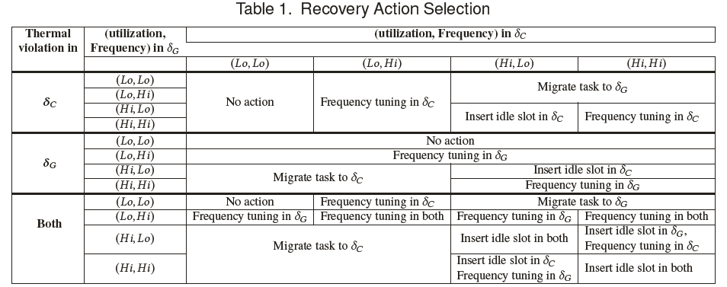
Thermal-aware Adaptive Platform Management for Heterogeneous Embedded Systems

Slide 33
Thank you!

